Slide 1
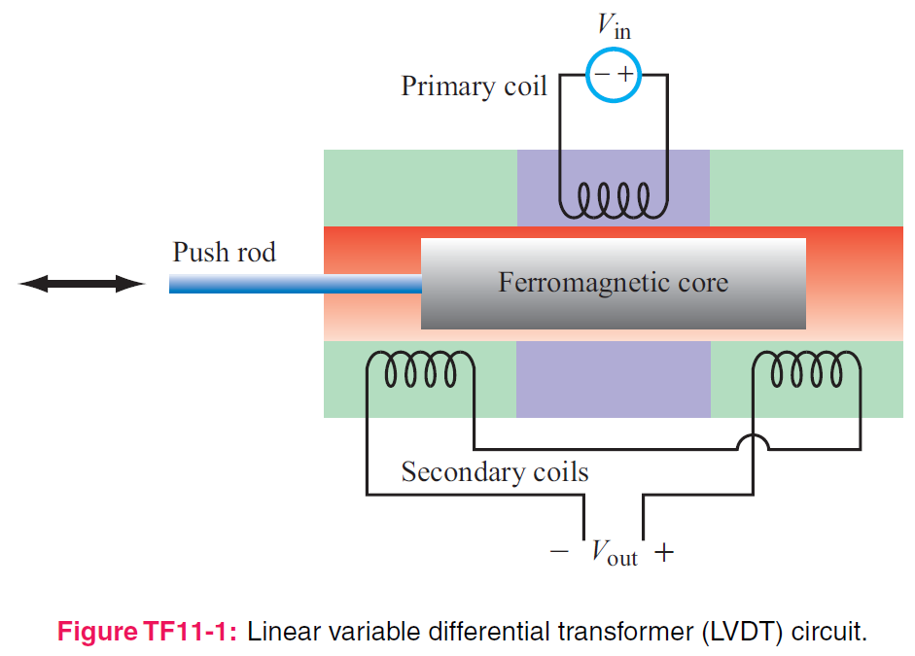
5. Magnetostatics
7e Applied EM by Ulaby and Ravaioli

Slide 2
Chapter 5 Overview

Slide 3
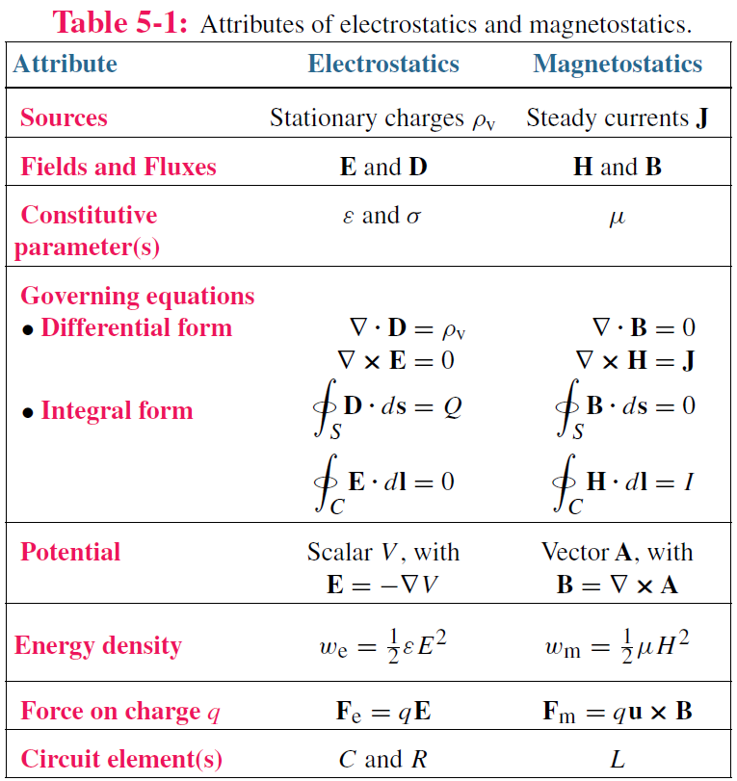
Electric vs Magnetic Comparison

Slide 4
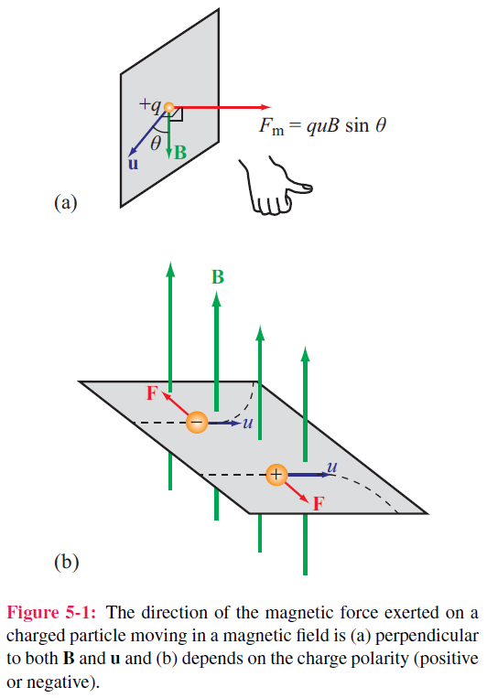

Electric & Magnetic Forces
Note the sign of q
Magnetic force
Electromagnetic (Lorentz) force
Tesla(T)
Three differences between F_{e} and F_{m}
PMW
NOT BMW
Perpendicular
Moving
Work
(because Fm ⊥u, only moving direction changes, not speed)

Slide 5
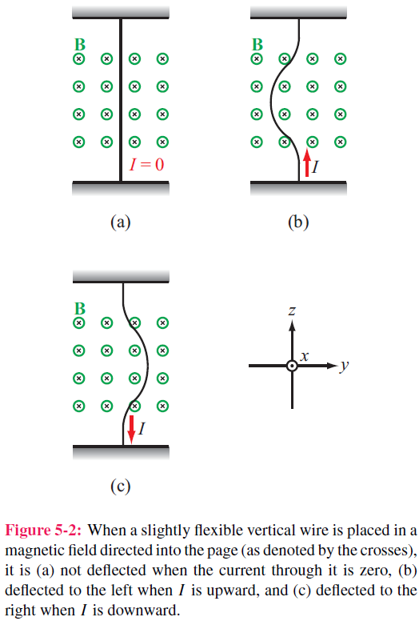
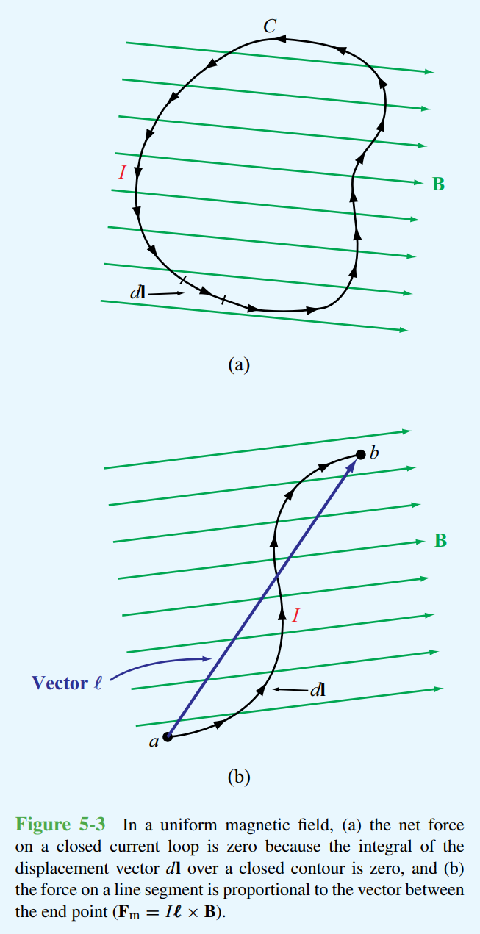
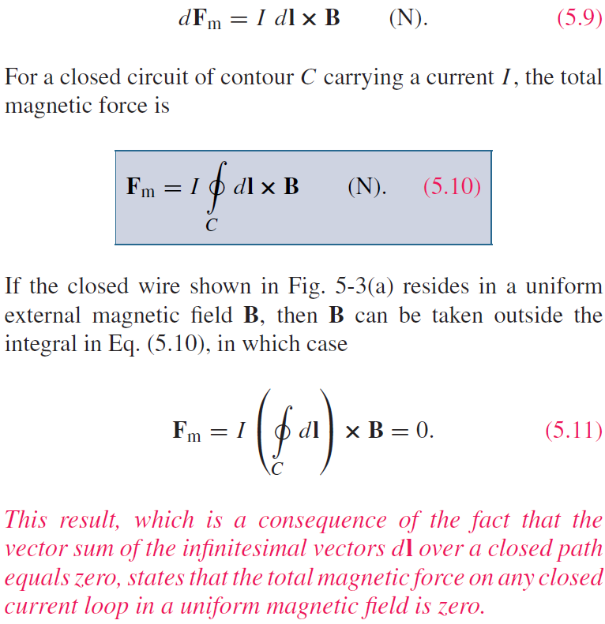

Magnetic Force on a Current Element
dl is the dispacement vector in the direction of current
Differential force dF_{m} on a differential current Idl:
$dFm=\frac{dq}{dt}\left(udt\right)×B=Idl×B$ (N) (5.9)
If the closed wire in Fig. 5-3(a) (see the right figure) is resides in a uniform B, then B can be taken outside the integral in Eq. (5.10), in which case

Slide 6
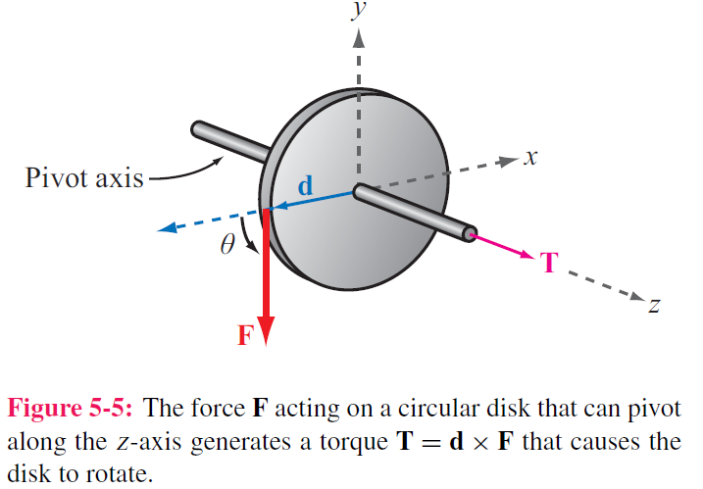

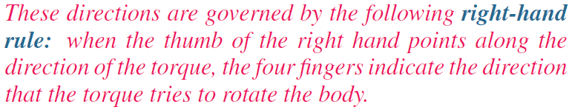
Torque
d = moment arm
F = force
T = torque
d connects the rotation axis and the application point of F

Slide 7
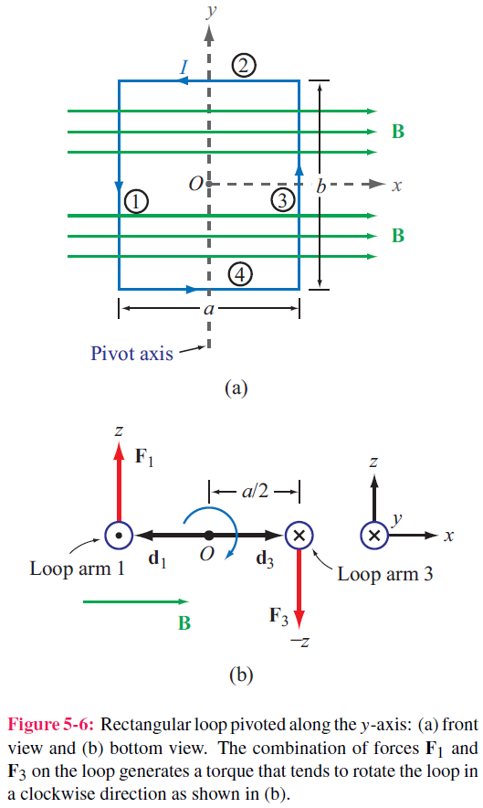
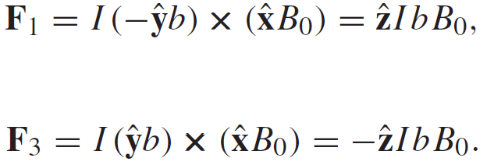
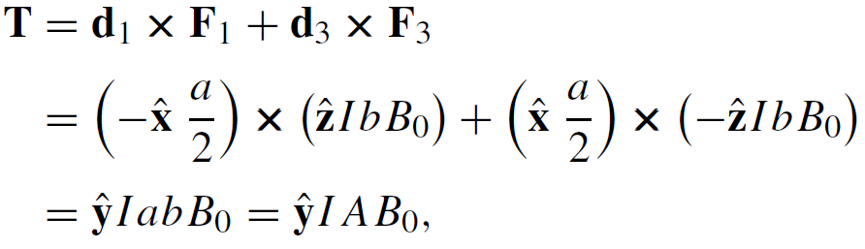
Magnetic Torque on a Current Loop
y
When B is in the plane of the loop
x
a rectangular conducting loop carries a current I.
· from
× into
No forces on arms 2 and 4 ( because I ∥ B)
Magnetic torque:
Area of the loop=ab

Slide 8
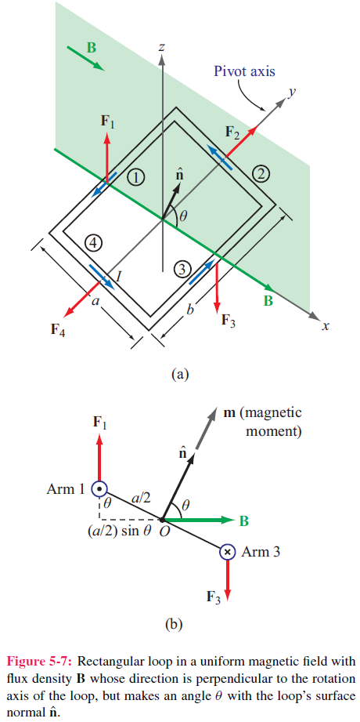
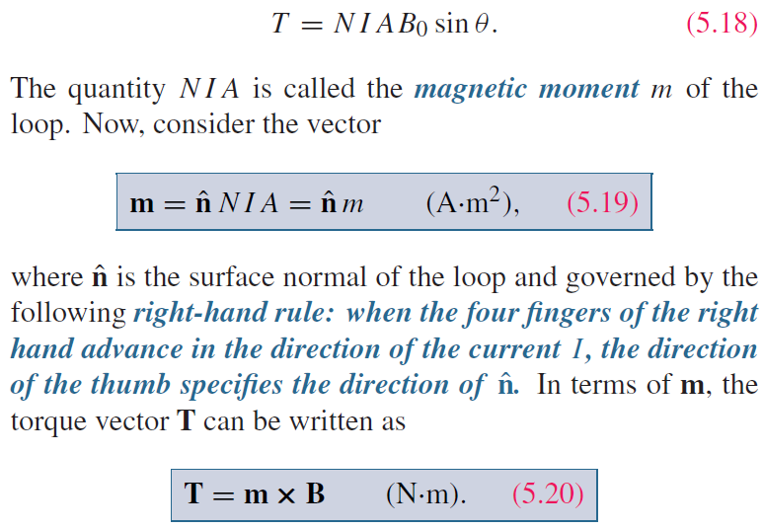
Inclined Loop
y
For a loop with N turns and whose surface normal is at angle θ (relative to the direction of B)
T： Maximum for parallel B (θ = 90◦)，
Zero for perpendicular B (θ = 0).
x

Slide 9
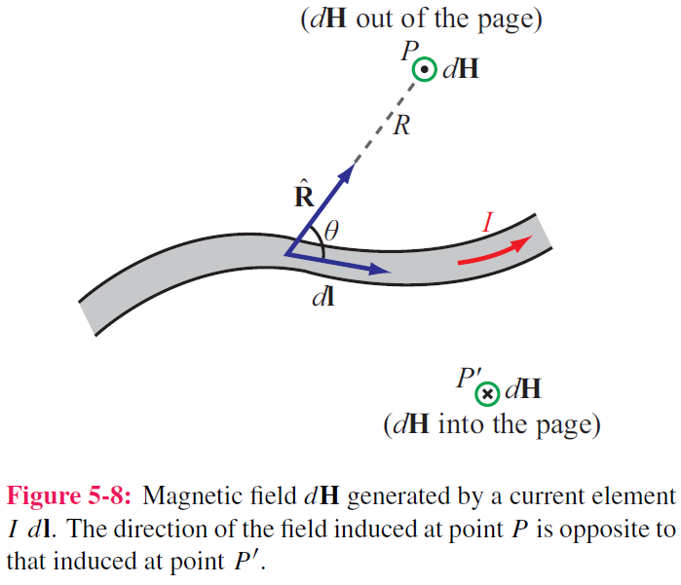

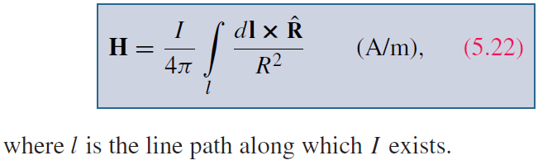
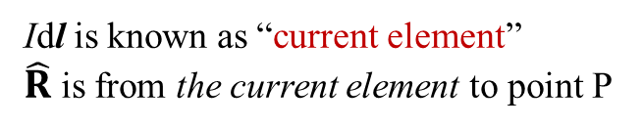
Biot-Savart Law
Idl is known as “current element”
$\hat{R}$is from the current element to point P
This law relates the magnetic field H at any point in space to the current I that generates H
For most materials the flux and field are linearly related by B = μH
Differential magnetic field dH generated by steady current I
through differential length vector dl
ampere·m/m²
Magnitude: varies as R ⁻²
Direction: orthogonal to ( Idl × R )
Total B due to the current

Slide 10
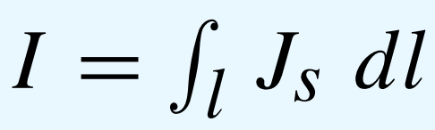
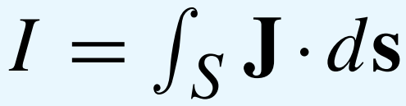
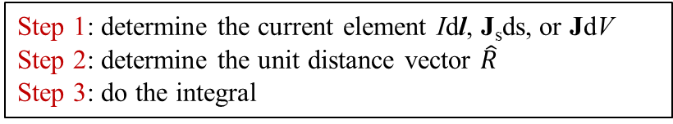
Magnetic Field due to Distributed Current Densities
Currents
(in A)
Current
Elements
(in A·m)
(A)·m
(A/m) ·m²
(A/m²) ·m³
Step 1: determine the current element Idl, J_{s}ds, or JdV
Step 2: determine the unit distance vector $\hat{R}$
Step 3: do the integral

Slide 11
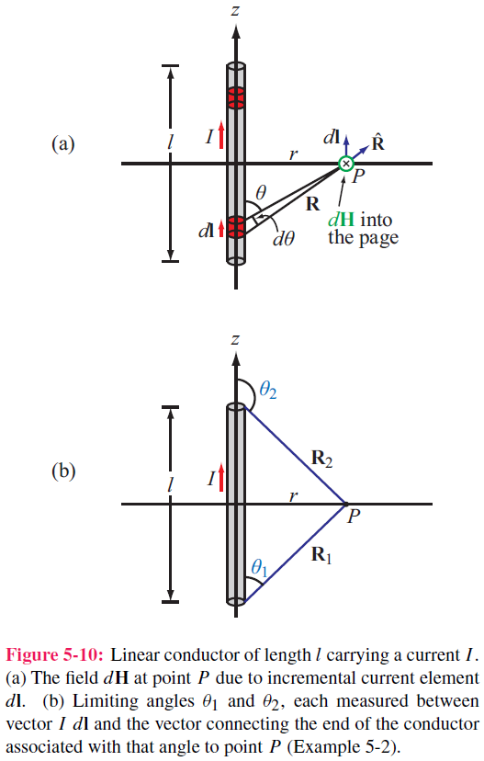
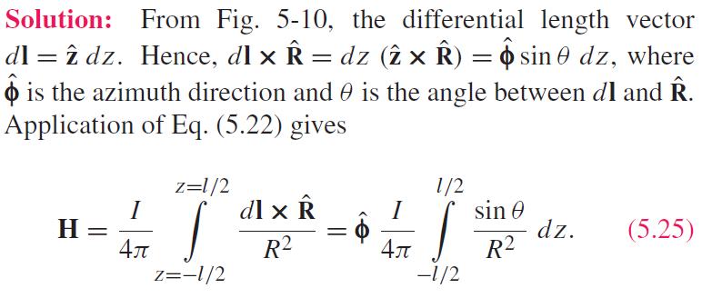
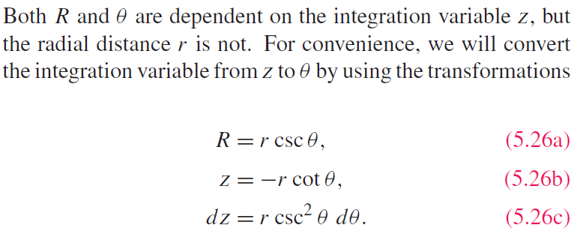
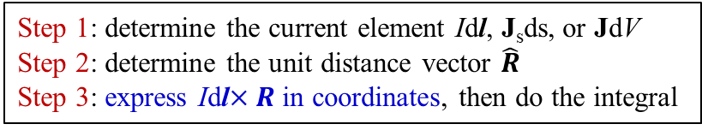
Example 5-2: Magnetic Field of Linear Conductor
Step 1: determine the current element Idl, J_{s}ds, or JdV
Step 2: determine the unit distance vector $\hat{R}$
Step 3: express Idl$×R$in coordinates, then do the integral
Cont.

Slide 12
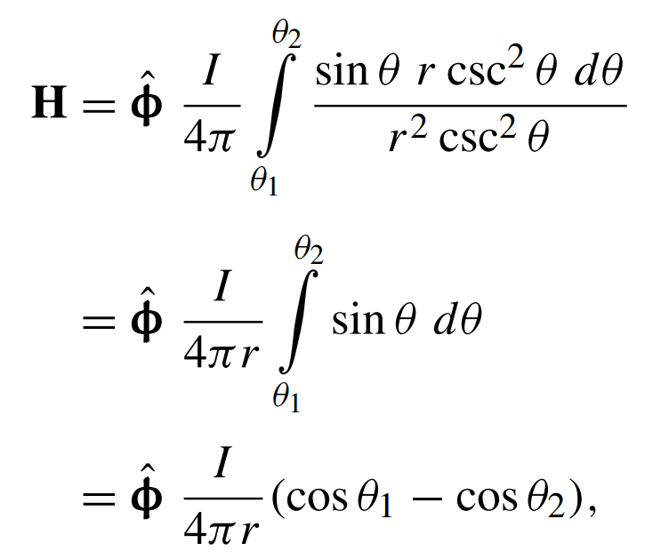
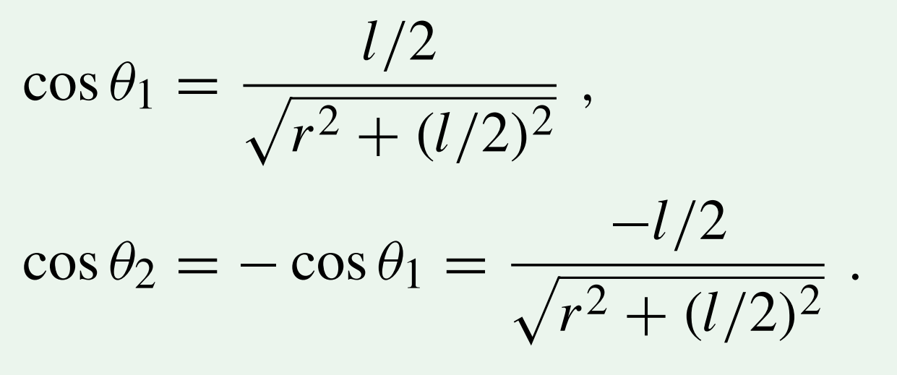
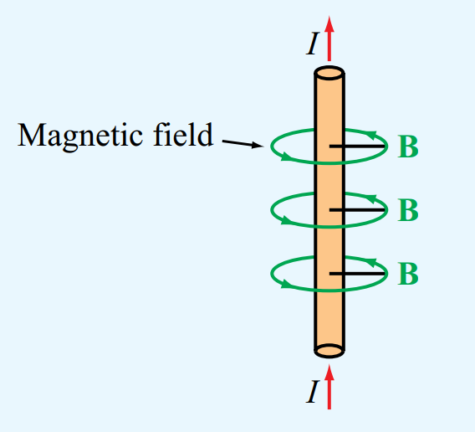
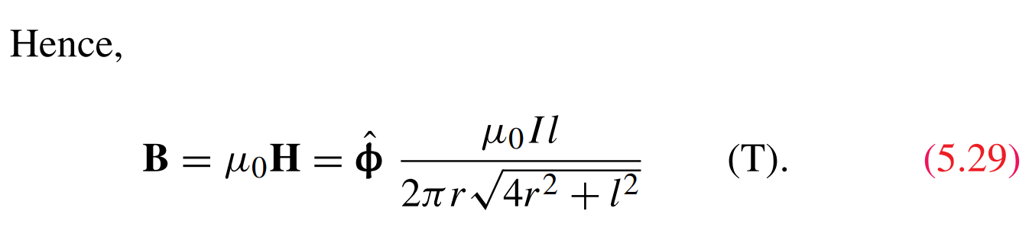
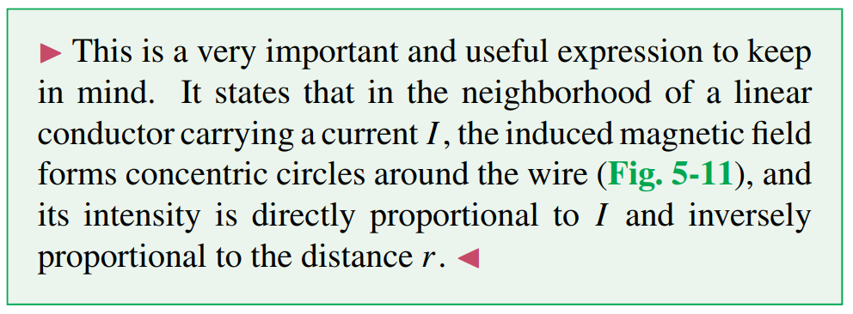
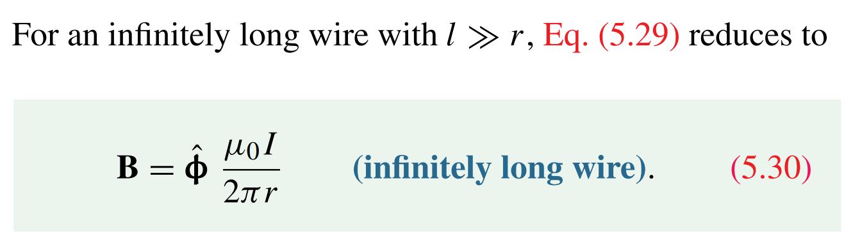
Example 5-2: Magnetic Field of Linear Conductor (cont.)

Slide 13
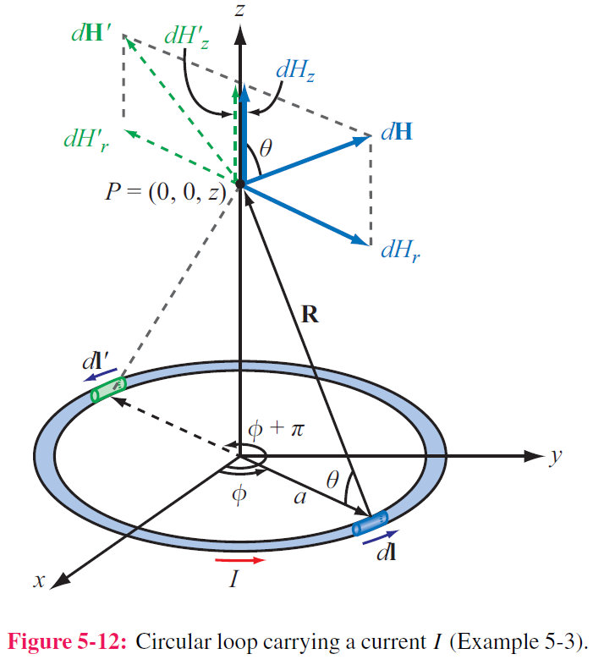
Example 5-3: Magnetic Field of a Loop
A circular loop of radius a carries a steady current I. Determine the magnetic field H at a point on the axis of the loop, i.e. at (0, 0, z).
z
Magnitude of dH due to current element Idl is
dH is in the r–z plane, thereby components dH_{r} and dH_{z}
(1) dH_{z} due to dl and dl’ add with each other
(2) dH_{r} due to dl and dl’ cancel with each other
Hence only H_{z} exists for a pair of elements
Idl and Idl’, which is
y
x
Cont.

Slide 14
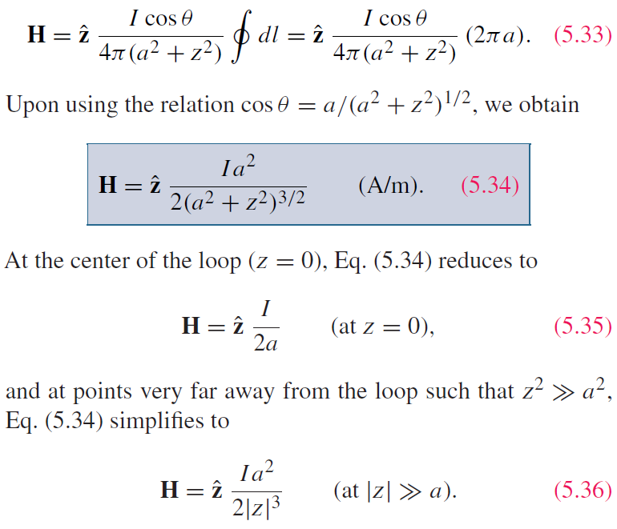
Example 5-3:Magnetic Field of a Loop (cont.)
Total H-field due to the entire current loop
The axial H-field decay so fast with |z|³ that your handphone has to be placed very close to the charging pad!

Slide 15
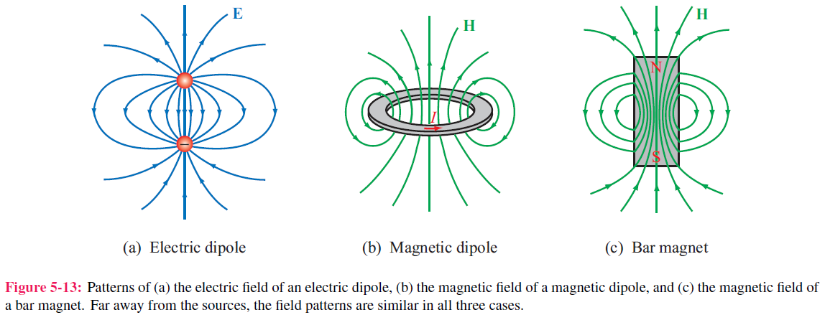
Magnetic Dipole
Definition: a small current loop, regardless of its shape
How small: the dimension of the loop is much smaller than the distance where you want to evaluate its field.
Why dipole: because a loop exhibits a magnetic field pattern similar to the electric field of an electric dipole, it is called a magnetic dipole

Slide 16
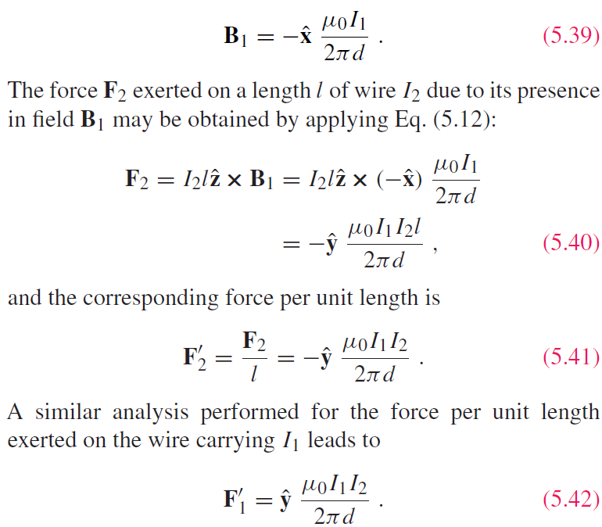
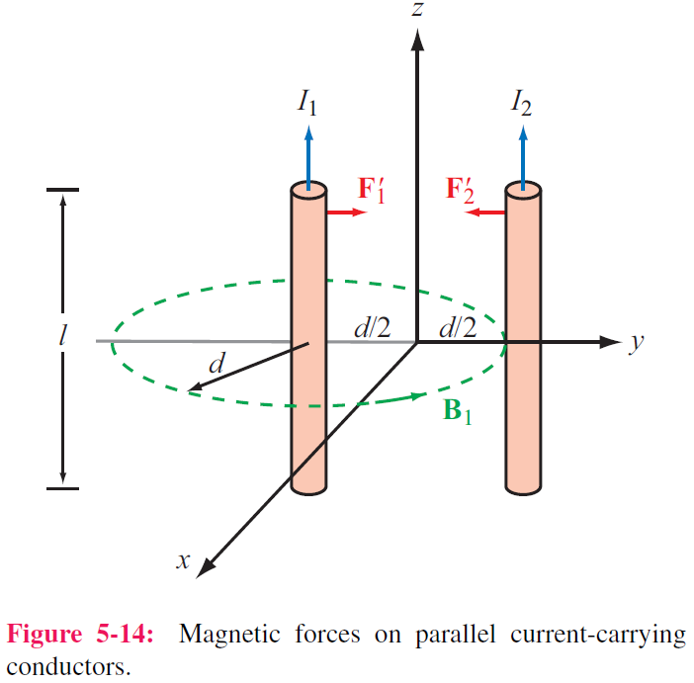
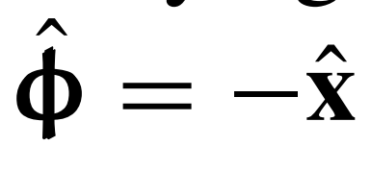
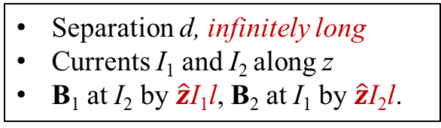
Forces on Parallel Conductors
Two wires closely placed with each other
Separation d, infinitely long
Currents I₁ and I₂ along z
B₁ at I₂ by $\hat{z}$I₁l, B₂ at I₁ by $\hat{z}$I₂l.
Current element ×Field
Parallel wires attract if their currents are in the same direction, and repel if currents are in opposite directions

Slide 17
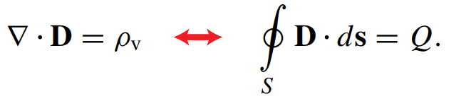
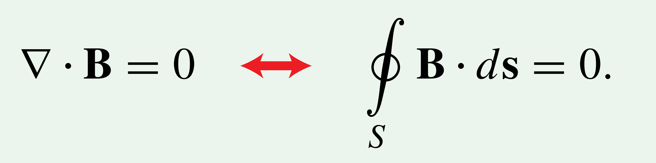
Gauss’s Law for Magnetism
Gauss’s Law for Electricity
Gauss’s Law for Magnetism
Zero at the right-hand side means that magnetic monopole (charge) does not exist in nature, but magnetic dipole exists.
Electrostatics
Magnetostatics
H Always Closed

Slide 18
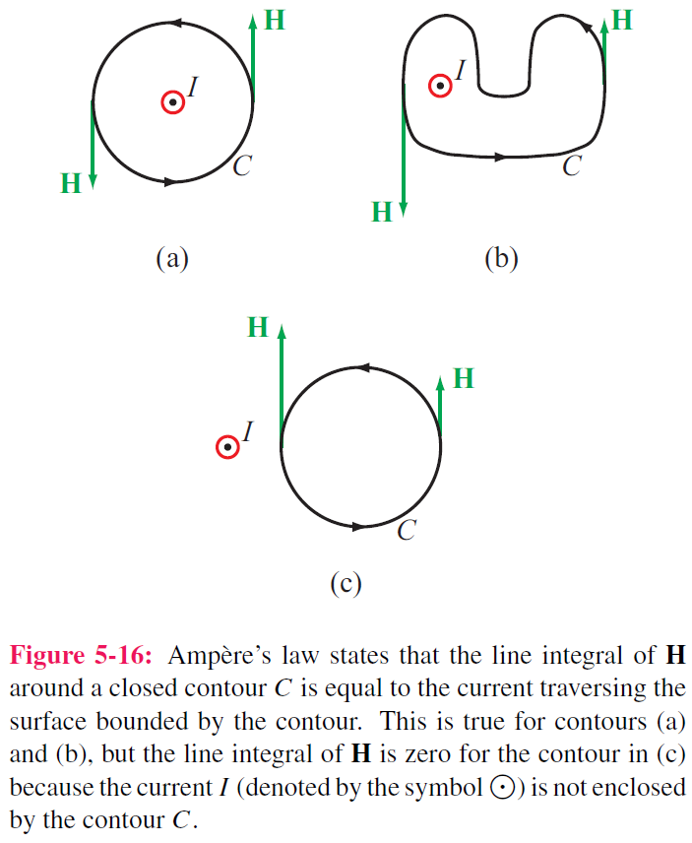
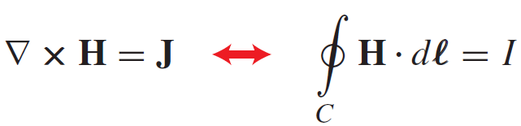
Ampère’s Law
Ampère’s circuital law states that the line integral of H around a closed path is equal to the current traversing the surface bounded by that path.
Conservative
Not Conservative unless I = 0
The direction of the path C is taken so that I and H satisfy the right-hand rule. That is, if the direction of I is aligned with the direction of the thumb of the right hand, then the direction of the contour C should be chosen along that of the other four fingers.

Slide 19
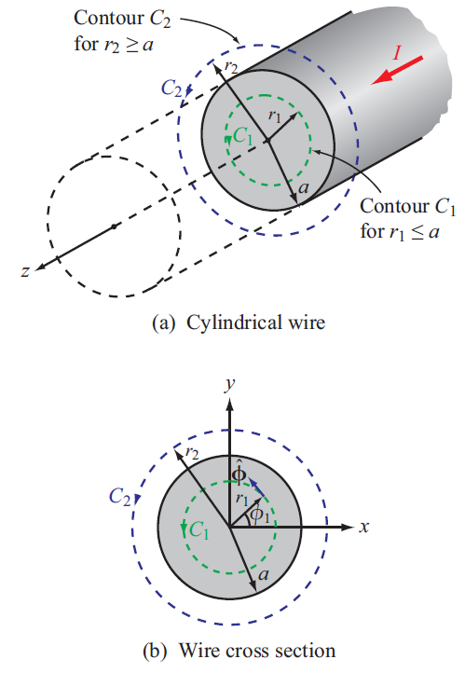
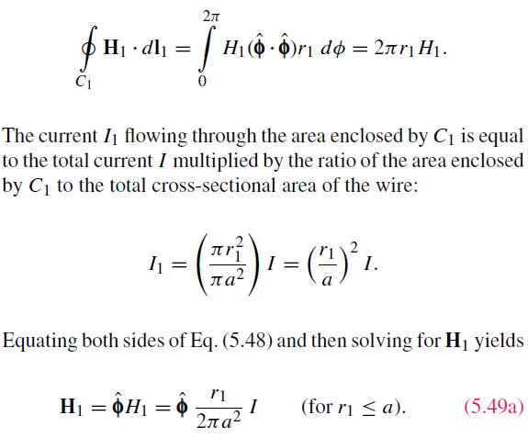
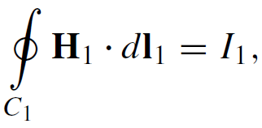
Internal Magnetic Field of a Long Wire
Current I along infinitely long wire. Find H at r from the wire for (a) r ≤ a (inside the wire) and (b) r ≥ a (outside the wire)
(a) r ≤ a
Cont.

Slide 20
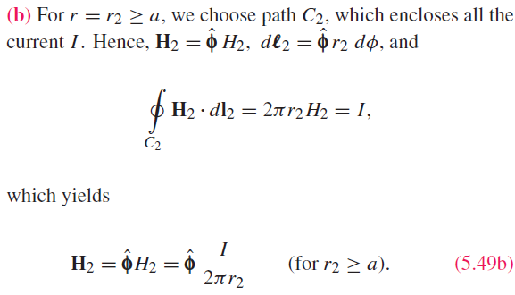
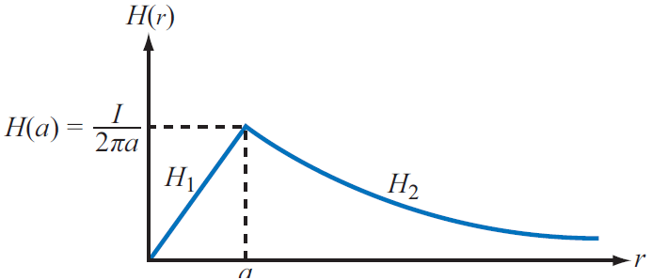
External Magnetic Field of Long Conductor
(b) r ≥ a

Slide 21
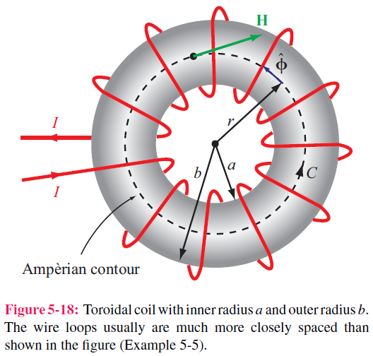
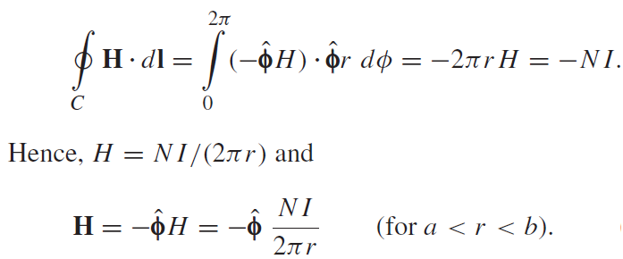
Magnetic Field of Toroid
Applying Ampere’s law over contour C:
Ampere’s law states that the line integral of H around a closed contour C is equal to the current traversing the surface bounded by the contour.
The magnetic field outside the toroid is zero. Why？

Slide 22
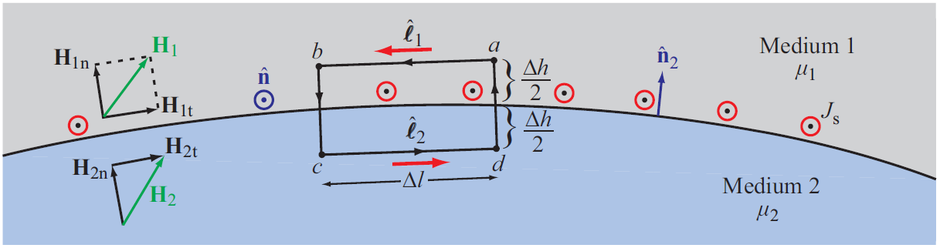
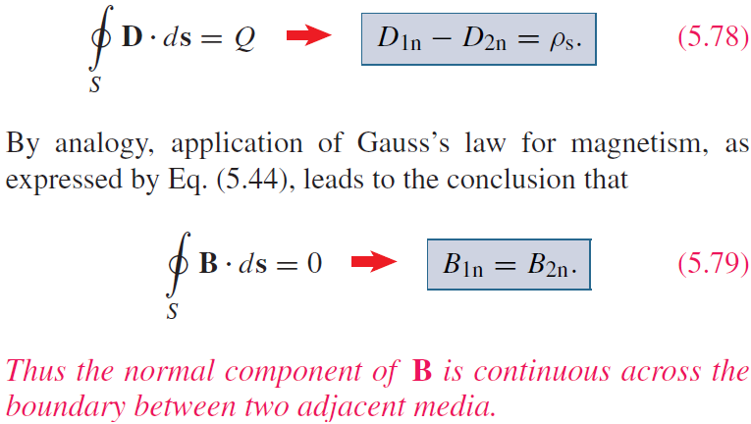
Magnetic Boundary Conditions
Norm of the loop
Tips:
1. the total charge density enclosed by a box equals to the total flux going outward
D_{n} jumps by ρ_{s}
(surface electric charge density)
B_{n} jumps by 0
(surface magnetic charge density)
2. the second boundary condition is for B_{n}, not for H_{n}. To solve the latter, B=μH is needed, where μ₁ ≠ μ₂ will lead to H_{1n} ≠ H_{2n}

Slide 23
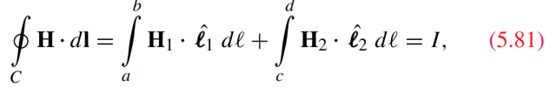









Boundary Conditions
Tips:
the total current density enclosed by a loop equals to the circulation
E_{t} jumps by 0 (magnetic current density?)
H_{t} jumps by J_{s} (electric current density)
n is normal to the loop
n₂ is normal to medium 2
Use Ampère’s Law and let $∆h→0$ (hence a thin line current of length Δl)
$\hat{n}×\vec{H}$ is always on the surface
Surface currents can exist only on the surfaces of perfect conductors and superconductors. Hence, at the interface between media with finite conductivities, Js = 0 and
H_{1t} = H_{2t}
$${\hat{n}}_{2}$$
$${\hat{l}}_{1}$$
·
$$\hat{n}$$
valid for arbitrary $\hat{n}$
(loop normal)

Slide 24







Boundary Condition for Finite σ
$$∇×\overset{⃑}{H}=\overset{⃑}{J}+\frac{∂\overset{⃑}{D}}{∂t}=σ\overset{⃑}{E}+\frac{∂\overset{⃑}{D}}{∂t}$$
$${\overset{⃑}{J}}_{s}=\int_{h_{1}}^{h_{2}}{{\overset{⃑}{J}}_{v}dh}≈\frac{∆h}{2}{\overset{⃑}{J}}_{v}$$
$$\oint_{C}{\overset{⃑}{H}∙d\overset{⃑}{l}}=σ∯_{S}{\overset{⃑}{E}∙d\overset{⃑}{s}}+\frac{∂}{∂t}∯_{S}{\overset{⃑}{D}∙d\overset{⃑}{s}}$$
$$∆h→0$$
$$\oint_{C}{\overset{⃑}{H}∙d\overset{⃑}{l}}=0$$
$${\overset{⃑}{J}}_{s}=0$$
$$∆h→0$$
Continuous

Slide 25


Solenoid
Inside the solenoid:

Slide 26



Inductance
Magnetic Flux
Flux Linkage
Inductance
Solenoid

Slide 27

Example 5-7: Inductance of Coaxial Cable
The magnetic field in the region S between the two conductors is approximately
Total magnetic flux through S:
Inductance per unit length:

Slide 28

Magnetic Energy
Magnetic field in the insulating material is
The magnetic energy stored in the
coaxial cable is

Slide 29

Summary

